Slide 1
Microservices. WCGW?
Uladzimir Abramchuk July 2018

Slide 2










What can go wrong?
x15

Slide 3
Possible answers
Dependency unavailable
Network issues
Misconfiguration
Eventual inconsistency
Poor performance
Security
Distributed transactions
UI composition
Versioning
Local development
Debugging
Whatever...

Slide 4
Use cron job

Slide 5
Use cron job
K8s v1.6
restartPolicy:OnFailure
Each run produces new pod in error state
Hundreds of pods in error state
Hi CPU usage by kubelet
Solution: Special image with cron inside

Slide 6
Start docker container

Slide 7
Start Docker container
Container outside k8s
restartPolicy: Always
Container was properly stopped
Container restarted after docker update (or docker restart)
Runs and consumes CPU
Solution: Don’t run containers manually on prod!
Notes:
ex-log collectors for Vzdrp

Slide 8
Use image from DockerHub

Slide 9
Use image from Docker Hub
Public GlusterFS image referenced
Particular image tag is removed
New containers won’t start if image has not been cached
Container won’t restart if imagePullPolicy:Always
Solution: Do not rely on public images
Notes:
Pushed image from another node to our docker registry

Slide 10
Use image from GitLab registry

Slide 11
Use image from GitLab registry
GitLab is sometimes out-of-space
It takes them up to 24 hours just to answer
Can be removed when cleaning up repos
Solution: Use OUR Docker Hub (or Nexus, when ready) to store images

Slide 12
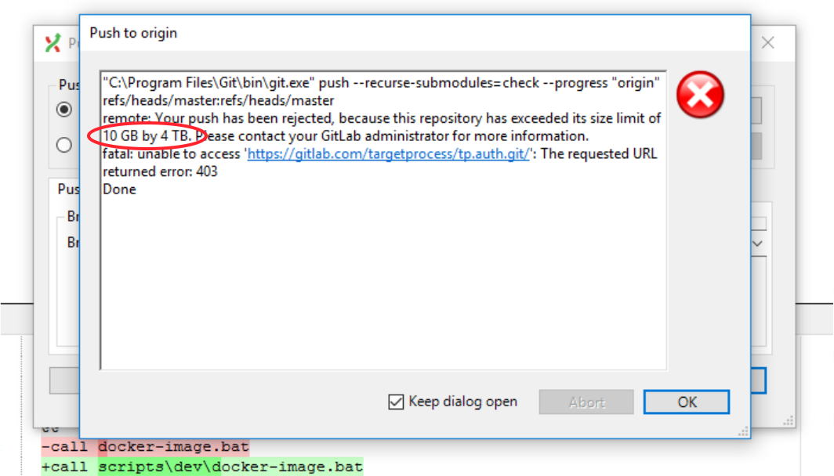

Slide 13
Restart all pods in namespace

Slide 14
Restart all pods in namespace
Delete pod then k8s will re-create it
Why bother if you can delete the whole namespace?
`helm upgrade --install` doesn’t re-create deleted namespace
https://github.com/helm/helm/issues/2013
Solution: Do not delete namespaces!
Notes:
Create namespace and everything will be set up by octopus

Slide 15
Do nothing

Slide 16
Use Elasticsearch

Slide 17
Use Elasticsearch
ES uses file cache
File cache counts as memory used
K8s doesn’t manage file cache and cannot free it
~8GB of file cache on each node with ES
Solution: just give up

Slide 18
Use Postgres

Slide 19
Use Postgres
Stolon manages Postgres cluster
Stolon uses libkv which supports etcd v2
Etcd cluster is managed by ectd-operator
Ectd-operator supports etcd v3
Etcd v2 and v3 APIs are not compatible
Solution: Added etcd v3 support to libkv

Slide 20
Use Postgres
Etcd persistence via backups
Cannot solve conflicts if actual state and backup diverged
Solution: Switched from etcd to consul

Slide 21
Use Postgres
Consul has issues with keys with TTL, sometimes they are not expired
Solution: Switched from consul to kube-api

Slide 22
Use Prometheus

Slide 23
Use Prometheus
Prometheus stores a lot of data in-memory
Swap is on the same SSD as system disk
When short on memory swap is actively used
The whole node becomes unresponsive
Solution: Turned off swap
Notes:
Swap is disabled where needed

Slide 24
Monitor GlusterFS

Slide 25
Monitor application

Slide 26
Monitor application
ServiceDesk monitored every request
Request URL was used as label
Prometheus used about 2GB memory
Turned off SD request monitoring
Prometheus memory consumption dropped to ~600-700MB
Solution: read documentation!

Slide 27
Write message to log

Slide 28
Write message to log
Fluentd reads new message from log
Fluentd imports message into ES
Fluentd writes success message in its own log
Fluentd reads new success message from its own log
…
Solution: be careful!

Slide 29
Write object to log

Slide 30
Write object to log
Elasticsearch has limit of 1000 fields by default
Write hashtable to log
Write request/response to log
Write credentials to log
Write …
Solution: log only necessary information, check again!

Slide 31
Login

Slide 32
Login
Log into Auth, TP, ServiceDesk (WOW, Single Sign-On!)
Auth, TP, ServiceDesk host on the same domain
400 Bad Request (Request Header Or Cookie Too Large)
Solution: adjust nginx(kong) settings

Slide 33
Setup services in cluster

Slide 34


Slide 35
Thank you!

